Slide 1
Space Law & the Moon
4 May 2022
Christopher D. Johnson
Space Law Advisor
Secure World Foundation
Professor of Law (Adjunct)
Georgetown University Law Center

Slide 2
Overview of this presentation:
The 1967 Outer Space Treaty contains numerous general provisions regulating space activities, and a few provisions specific to lunar activities.
The Artemis Accords largely re-iterates these provisions, with a few novel innovations and clarifications.
Actual lunar economic development necessitates further specificity in the law (whether at international, national, or contractual levels)
These slides are available at: https://bit.ly/LSICMay4

Slide 3
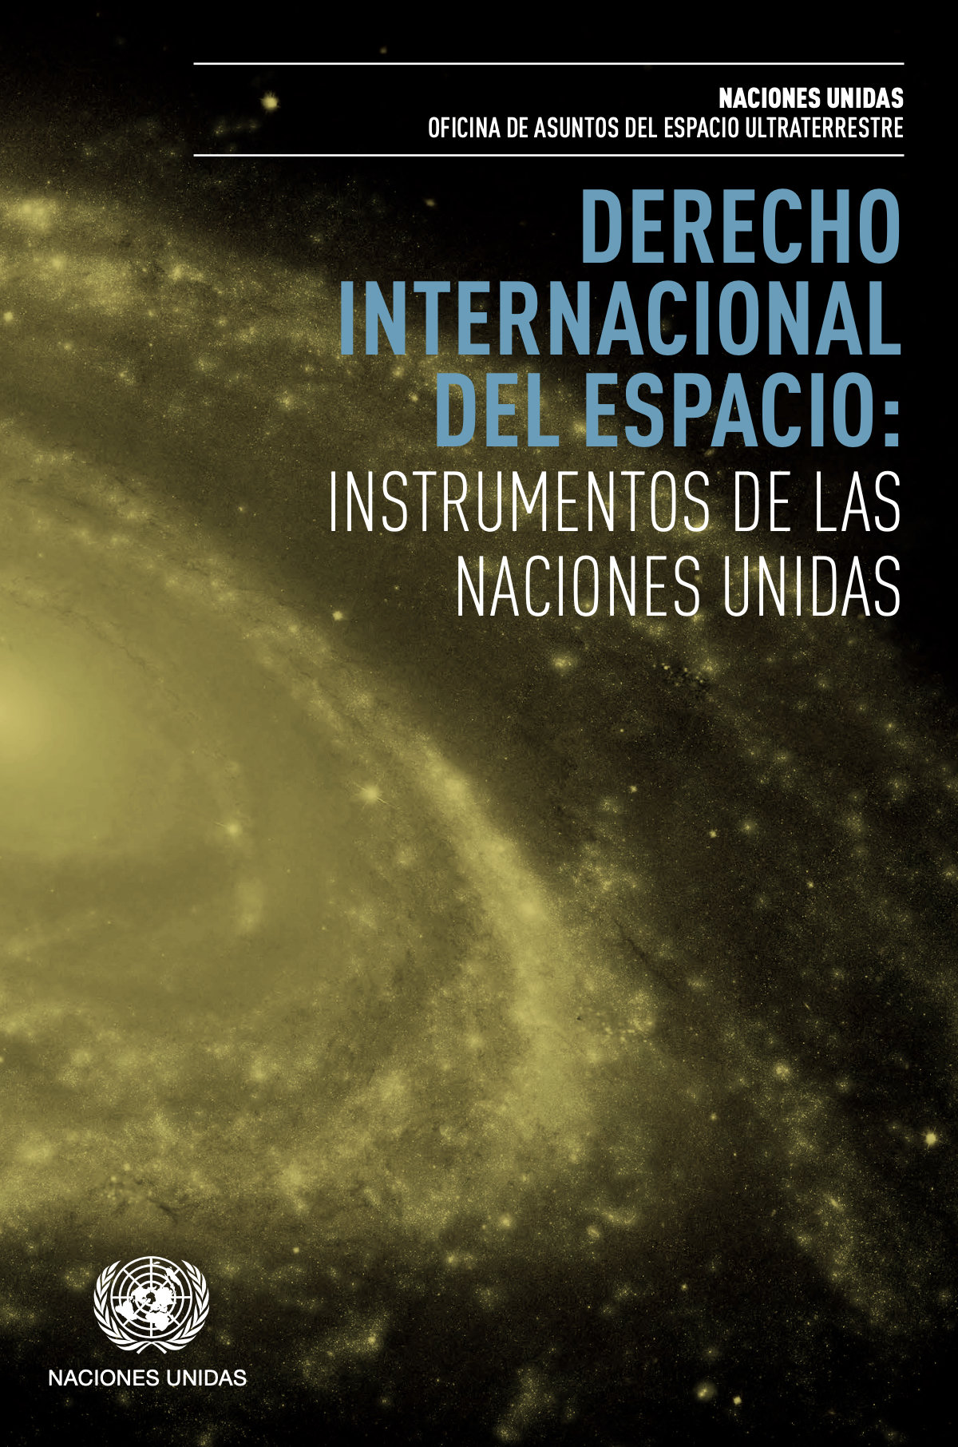
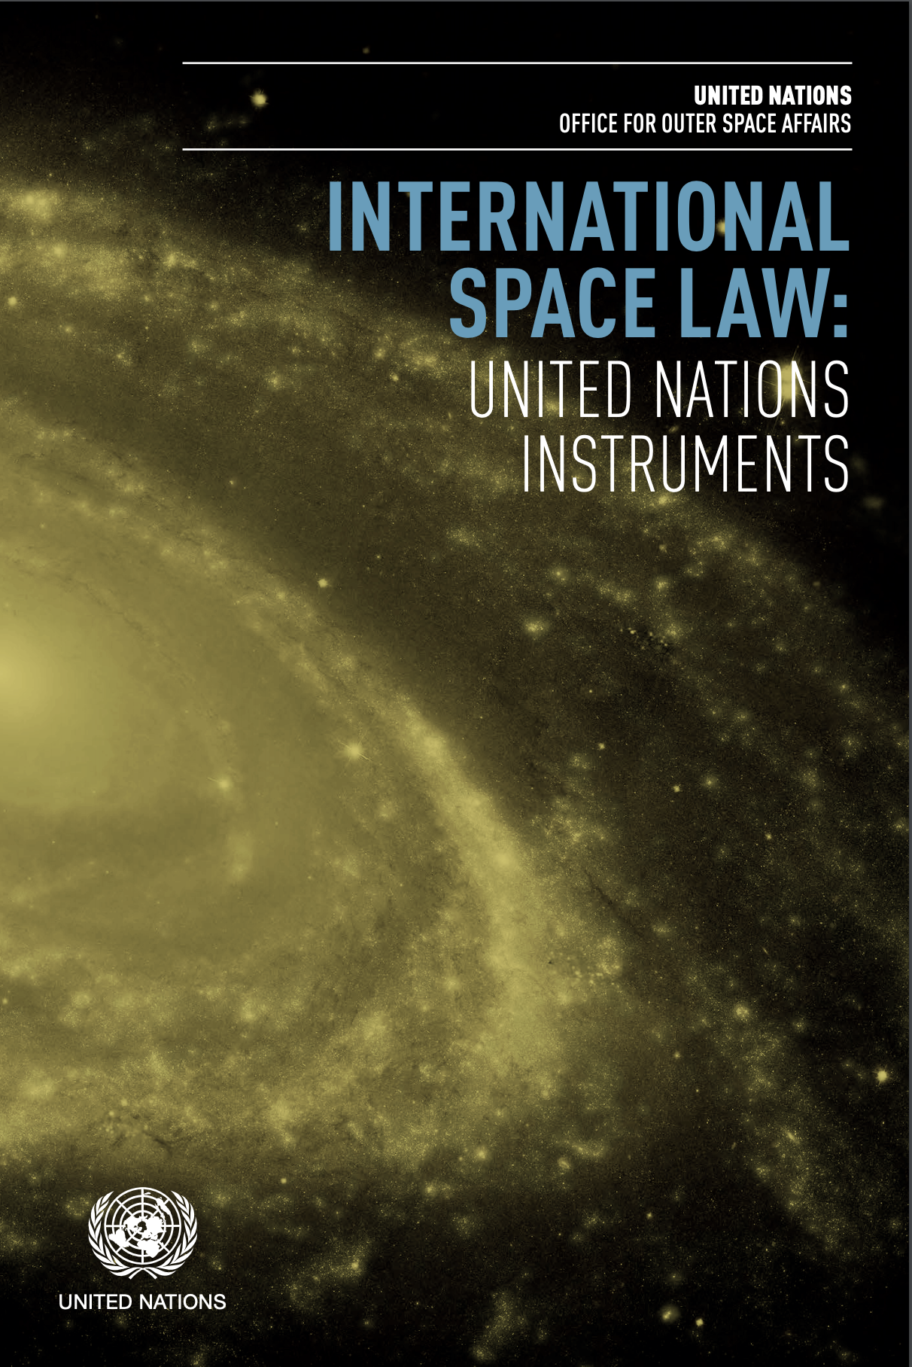
International Space Law
Treaty booklets available in all UN languages at
https://www.unoosa.org/oosa/oosadoc/data/documents/2017/stspace/stspace61rev.2_0.html

Slide 4
1967 Outer Space Treaty
The most important source of international space law.
As of 2022, 111 States are party to the Outer Space Treaty.
23 States have signed (but not yet ratified) the Outer Space Treaty.
All of the major, historical space powers, middle space powers, and emerging space powers are party to the Outer Space Treaty.
Treaty booklets available in all UN languages at
https://www.unoosa.org/oosa/oosadoc/data/documents/2017/stspace/stspace61rev.2_0.html

Slide 5
Principal Elements of the
1967 Outer Space Treaty
Art. 1 – Freedom of exploration and use
Art. 2 – Principle of non-appropriation
Art. 3 – Applicability of international law to space
Art. 4 – Non-weaponization of outer space & the Moon
Art. 5 – Treatment of astronauts
Art. 6 – International responsibility
Art. 7 – International liability
Art. 8 – Jurisdiction & control
Art. 9 – Cooperation & mutual assistance; due regard
Art. 12 - Reciprocal visitation on the Moon

Slide 6
Article
One
Freedom of Exploration and Use

Slide 7
The exploration and use of outer space, including the Moon and other celestial bodies, shall be carried out for the benefit and in the interests of all countries, irrespective of their degree of economic or scientific development, and shall be the province of all mankind.
Article One
Sentence 1

Slide 8
Outer space, including the Moon and other celestial bodies, shall be free for exploration and use by all States without discrimination of any kind, on a basis of equality and in accordance with international law, and there shall be free access to all areas of celestial bodies.
Article One
Sentence 2

Slide 9
There shall be freedom of scientific investigation in outer space, including the Moon and other celestial bodies, and States shall facilitate and encourage international cooperation in such investigation.
Article One
Sentence 3

Slide 10
Article
Two
Principle of Non-Appropriation

Slide 11
Outer space, including the Moon and other celestial bodies, is not subject to national appropriation by claim of sovereignty, by means of use or occupation, or by any other means.
Article Two
Notes:
A mere 30 words

Slide 12
Article
Four
Non-Weaponization of Outer Space

Slide 13
States Parties to the Treaty undertake not to place in orbit around the Earth any objects carrying nuclear weapons or any other kinds of weapons of mass destruction, install such weapons on celestial bodies, or station such weapons in outer space in any other manner.
Article Four
Paragraph 1

Slide 14
The Moon and other celestial bodies shall be used by all States Parties to the Treaty exclusively for peaceful purposes.
The establishment of military bases, installations and fortifications, the testing of any type of weapons and the conduct of military manoeuvres on celestial bodies shall be forbidden.
Article Four
Paragraph 2
Sentences 1 & 2

Slide 15
The use of military personnel for scientific research or for any other peaceful purposes shall not be prohibited.
The use of any equipment or facility necessary for peaceful exploration of the Moon and other celestial bodies shall also not be prohibited.
Article Four
Paragraph 2
Sentences 3 & 4

Slide 16
Article
6
International Responsibility

Slide 17
States Parties to the Treaty shall bear international responsibility for national activities in outer space, including the Moon and other celestial bodies, whether such activities are carried on by governmental agencies or by non-governmental entities, and for assuring that national activities are carried out in conformity with the provisions set forth in the present Treaty.
Article Six
Sentence 1

Slide 18
The activities of non-governmental entities in outer space, including the Moon and other celestial bodies, shall require authorization and continuing supervision by the appropriate State Party to the Treaty.
Article Six
Sentence 2

Slide 19
Article
7
International Liability

Slide 20
Article
8
Jurisdiction and Control

Slide 21
Article
9
Cooperation & Mutual Assistance
Due Regard & Harmful Contamination

Slide 22
In the exploration and use of outer space, including the Moon and other celestial bodies, States Parties to the Treaty shall be guided by the principle of cooperation and mutual assistance and shall conduct all their activities in outer space, including the Moon and other celestial bodies, with due regard to the corresponding interests of all other States Parties to the Treaty.
Article 9
Sentence 1

Slide 23
States Parties to the Treaty shall pursue studies of outer space, including the Moon and other celestial bodies, and conduct exploration of them so as to avoid their harmful contamination and also adverse changes in the environment of the Earth resulting from the introduction of extraterrestrial matter and, where necessary, shall adopt appropriate measures for this purpose.
Article 9
Sentence 2

Slide 24
Article
12
Visitations on the Moon

Slide 25
All stations, installations, equipment and space vehicles on the Moon and other celestial bodies shall be open to representatives of other States Parties to the Treaty on a basis of reciprocity.
Such representatives shall give reasonable advance notice of a projected visit, in order that appropriate consultations may be held and that maximum precautions may be taken to assure safety and to avoid interference with normal operations in the facility to be visited.
Article 12

Slide 26
The Artemis
Accords

Slide 27
The Artemis Accords
Currently, 18 states are signatories to the Artemis Accords
Australia, Bahrain, Brazil, Canada, Israel, Italy, Japan, South Korea, Luxembourg, Mexico, New Zealand, Poland, Romania, Singapore,
Ukraine, UAE, UK, and USA.
Available at: NASA /The Artemis Accords

Slide 28
Principal Elements of the
Artemis Accords
Peaceful Purposes
Transparency
Interoperability
Emergency Assistance
Registration of Space Objects
Release of Scientific Data
Preserving Outer Space Heritage
Space Resources
Deconfliction of Space Activities
Orbital Debris

Slide 29
Section 4
Interoperability

Slide 30
The Signatories commit to use reasonable efforts to utilize current interoperability standards for space-based infrastructure, to establish such standards when current standards do not exist or are inadequate, and to follow such standards.
Section 5
Interoperability

Slide 31
Section 10
Space Resources

Slide 32
The Signatories affirm that the extraction of space resources does not inherently constitute national appropriation under Article II of the Outer Space Treaty, and that contracts and other legal instruments relating to space resources should be consistent with that Treaty.
The Signatories intend to use their experience under the Accords to contribute to multilateral efforts to further develop international practices and rules applicable to the extraction and utilization of space resources, including through ongoing efforts at the COPUOS.
Section 10
Space Resources [in part]

Slide 33
Section 11
Deconfliction of Space Activities

Slide 34
4. The Signatories commit to seek to refrain from any intentional actions that may create harmful interference with each other’s use of outer space in their activities under these Accords.
Section 11
Deconfliction of Space Activities [in part]

Slide 35
7. … the Signatories intend to provide notification of their activities and commit to coordinating with any relevant actor to avoid harmful interference.
The area wherein this notification and coordination will be implemented to avoid harmful interference is referred to as a ‘safety zone’.
A safety zone should be the area in which nominal operations of a relevant activity or an anomalous event could reasonably cause harmful interference.
Section 11
Deconfliction of Space Activities [in part]

Slide 36
National Approaches
On space resources

Slide 37
National Space Legislation on Space Mineral Resources
United States of America
US Commercial Space Launch Competitiveness Act (2015)
Luxembourg
Law on the Exploration and Use of Space Resources (2017)
Law on Space Activities (2020)
United Arab Emirates
Federal Law on the Regulation of the Space Sector (2019)
Japan
Space Activities Act (2018)
Space Resources Act (2021)

Slide 38
National Space Legislation on Space Mineral Resources
United States of America
US Commercial Space Launch Competitiveness Act (2015)
Title IV — Space Resources Exploration and Utilization
§51301 Definitions.
In this chapter:
ASTEROID RESOURCE.—The term ‘asteroid resource’ means a space resource found on or within a single asteroid.
SPACE RESOURCE.—
IN GENERAL.—The term ‘space resource’ means an abiotic resource in situ in outer space.
INCLUSIONS.—The term ‘space resource’ includes water and minerals.
UNITED STATES CITIZEN.—The term ‘United States citizen’ has the meaning given the term ‘citizen of the United States’ in section 50902.

Slide 39
National Space Legislation on Space Mineral Resources
United States of America
US Commercial Space Launch Competitiveness Act (2015)
Title IV — Space Resources Exploration and Utilization
§51302 Commercial exploration and commercial recovery
a. In General.—The President, acting through appropriate Federal agencies, shall—
facilitate commercial exploration for and commercial recovery of space resources by United States citizens;
discourage government barriers to the development in the United States of economically viable, safe, and stable industries for commercial exploration for and commercial recovery of space resources in manners consistent with the international obligations of the United States; and
promote the right of United States citizens to engage in commercial exploration for and commercial recovery of space resources free from harmful interference, in accordance with the international obligations of the United States and subject to authorization and continuing supervision by the Federal Government.

Slide 40
National Space Legislation on Space Mineral Resources
United States of America
US Commercial Space Launch Competitiveness Act (2015)
Title IV — Space Resources Exploration and Utilization
§51303 Asteroid resource and space resource rights.
A United States citizen engaged in commercial recovery of an asteroid resource or a space resource under this chapter shall be entitled to any asteroid resource or space resource obtained, including to possess, own, transport, use, and sell the asteroid resource or space resource obtained in accordance with applicable law, including the international obligations of the United States.
* See also 2020 Presidential Executive Order on Space Resources

Slide 41
Thank You
Christopher Johnson
cjohnson@swfound.org
These slides are available at: https://bit.ly/LSICMay4

